Slide 1
Lecture 1
1.2 A Fast Urbanizing World: Opportunities and Challenges
©Luís M. A. Bettencourt 2024
IUS Chapter 1

Slide 2
Why Study Cities? Why Now?

Slide 3
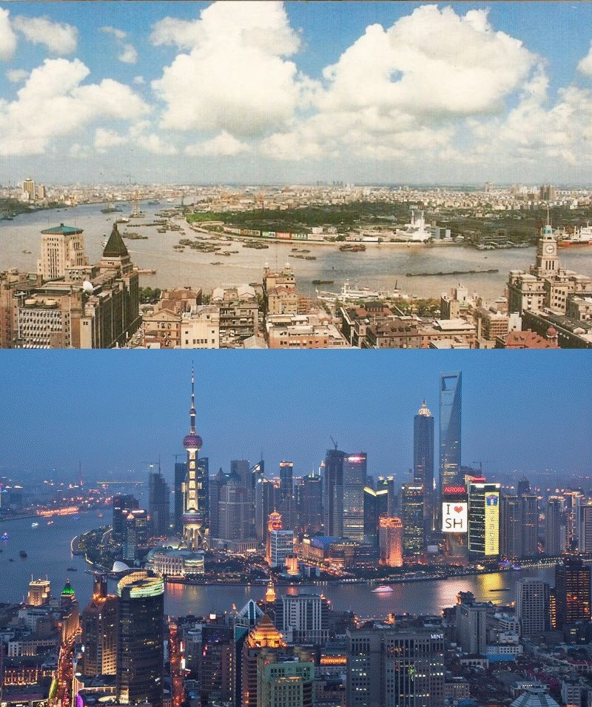
1987
Shanghai
2012
credit: telegraph/reuters/jesus diaz
Notes:
This sort of change in one generation is only possible in cities, through cities. Note that even though we are seeing a change in the built environment in this picture, the lives of people in these two situations are also completely different: what they do, how they live, what they know, what they buy and sell, etc

Slide 4
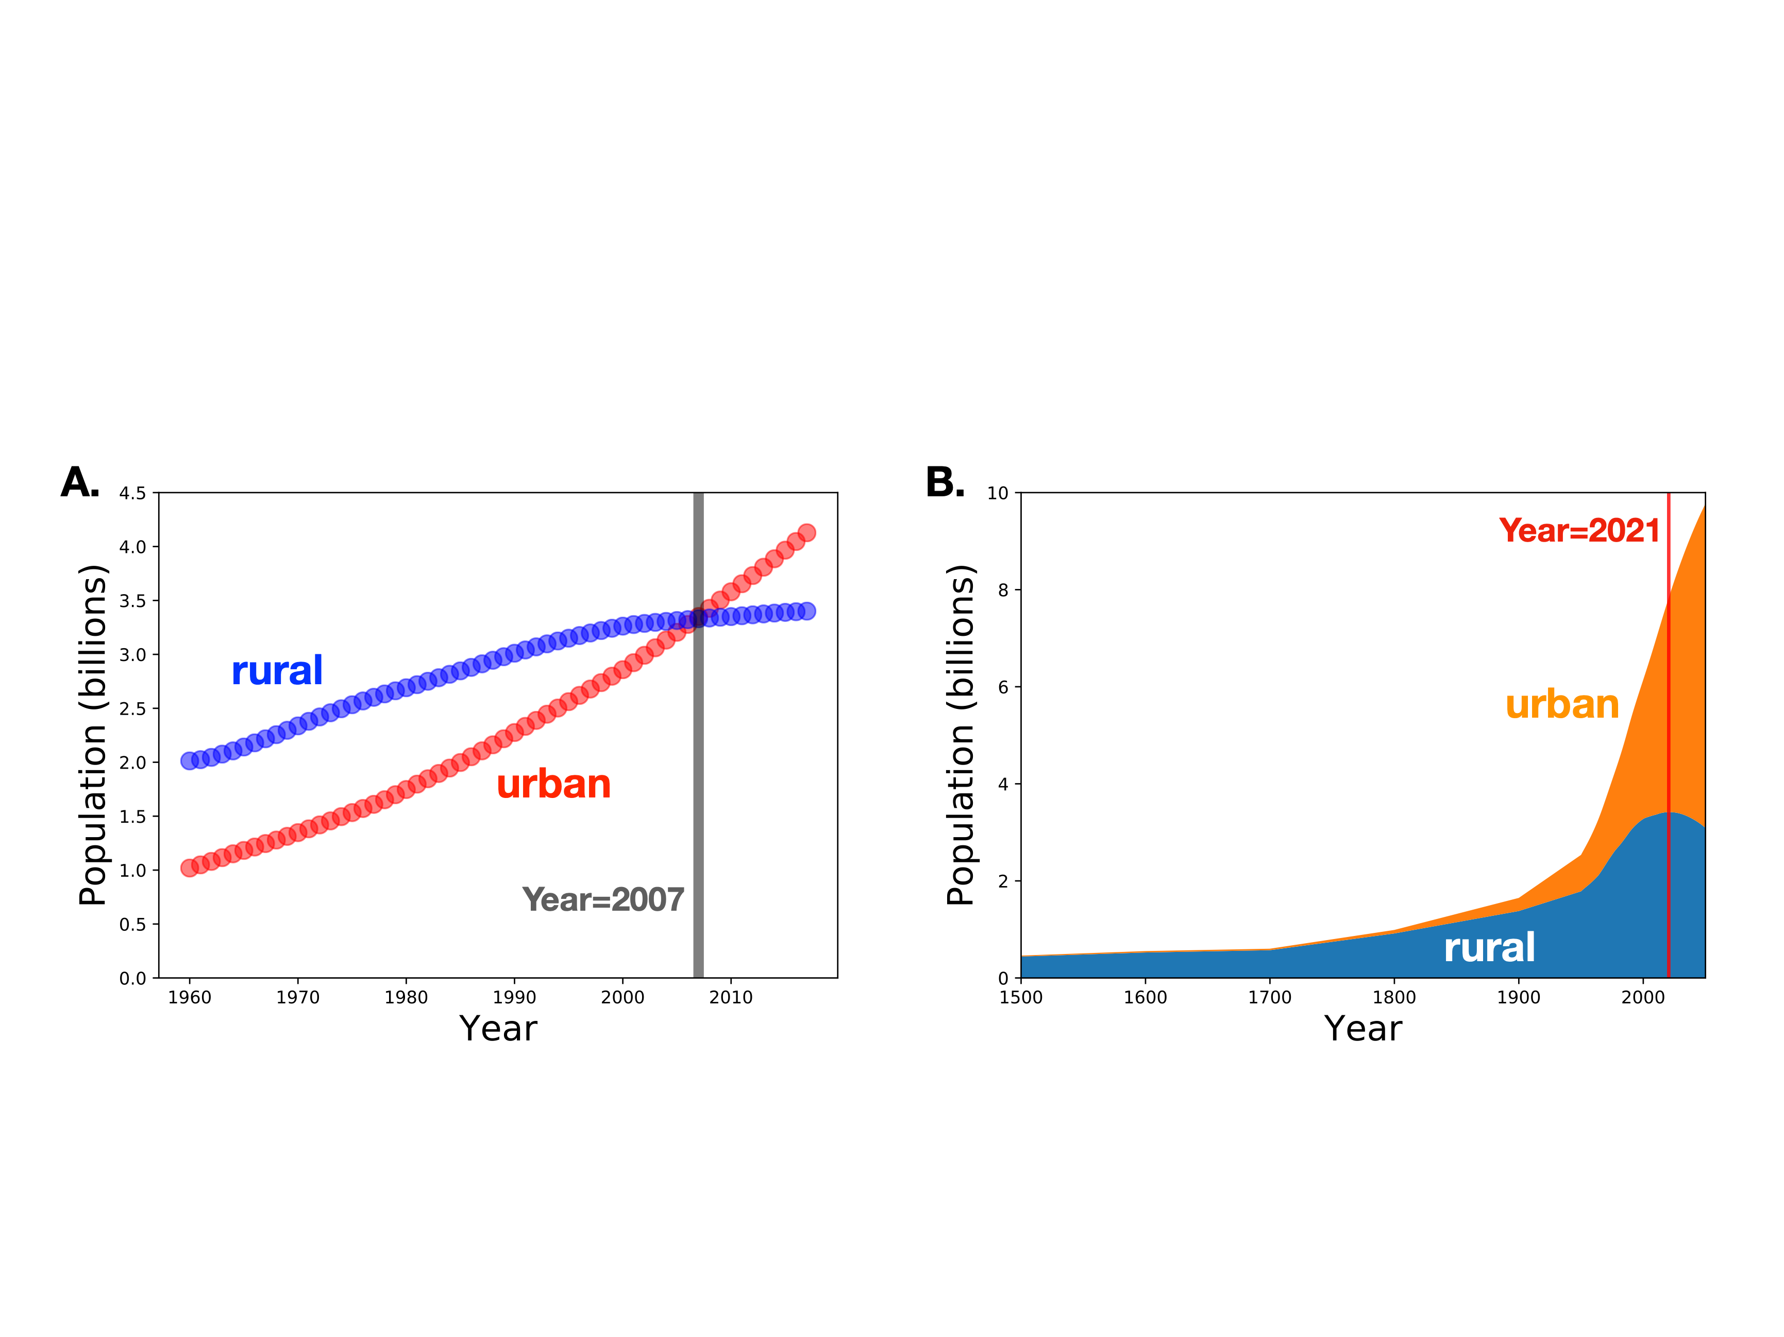
1. “Universality”: The World is Urbanizing Everywhere Fast
Two world changing events.
Notes:
These are typical facts about urbanization. And two key dates.

Slide 5
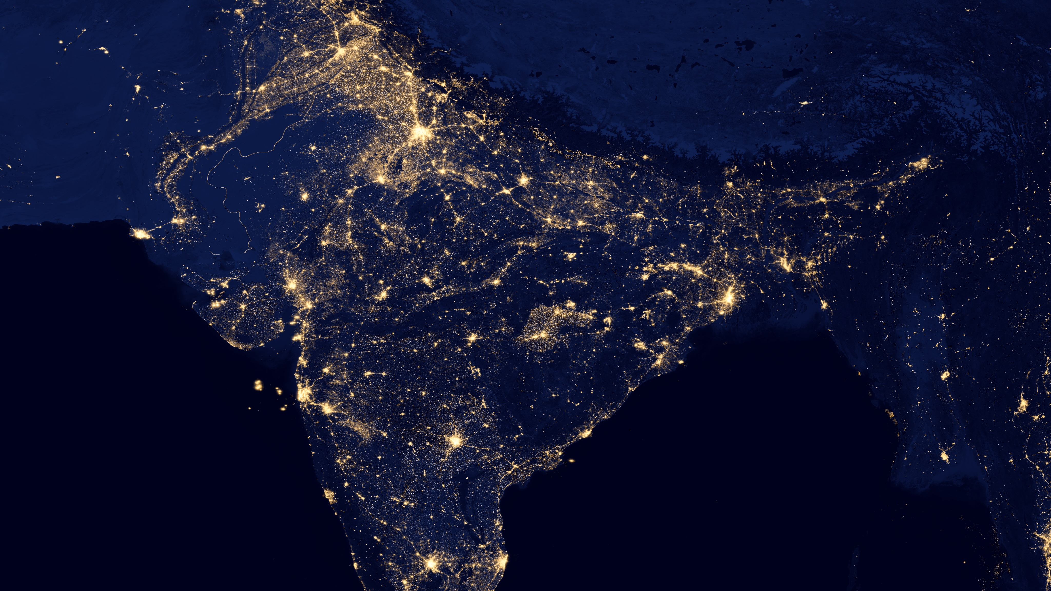
credit: NASA 2012
Notes:
Always amazing to look at night lights and see all the cities (of India). Feels like the sky on earth, and we will see later why. If we could see economic productivity or knowledge this picture would even brighter as such quantities are even more concentrated in larger cities.

Slide 6
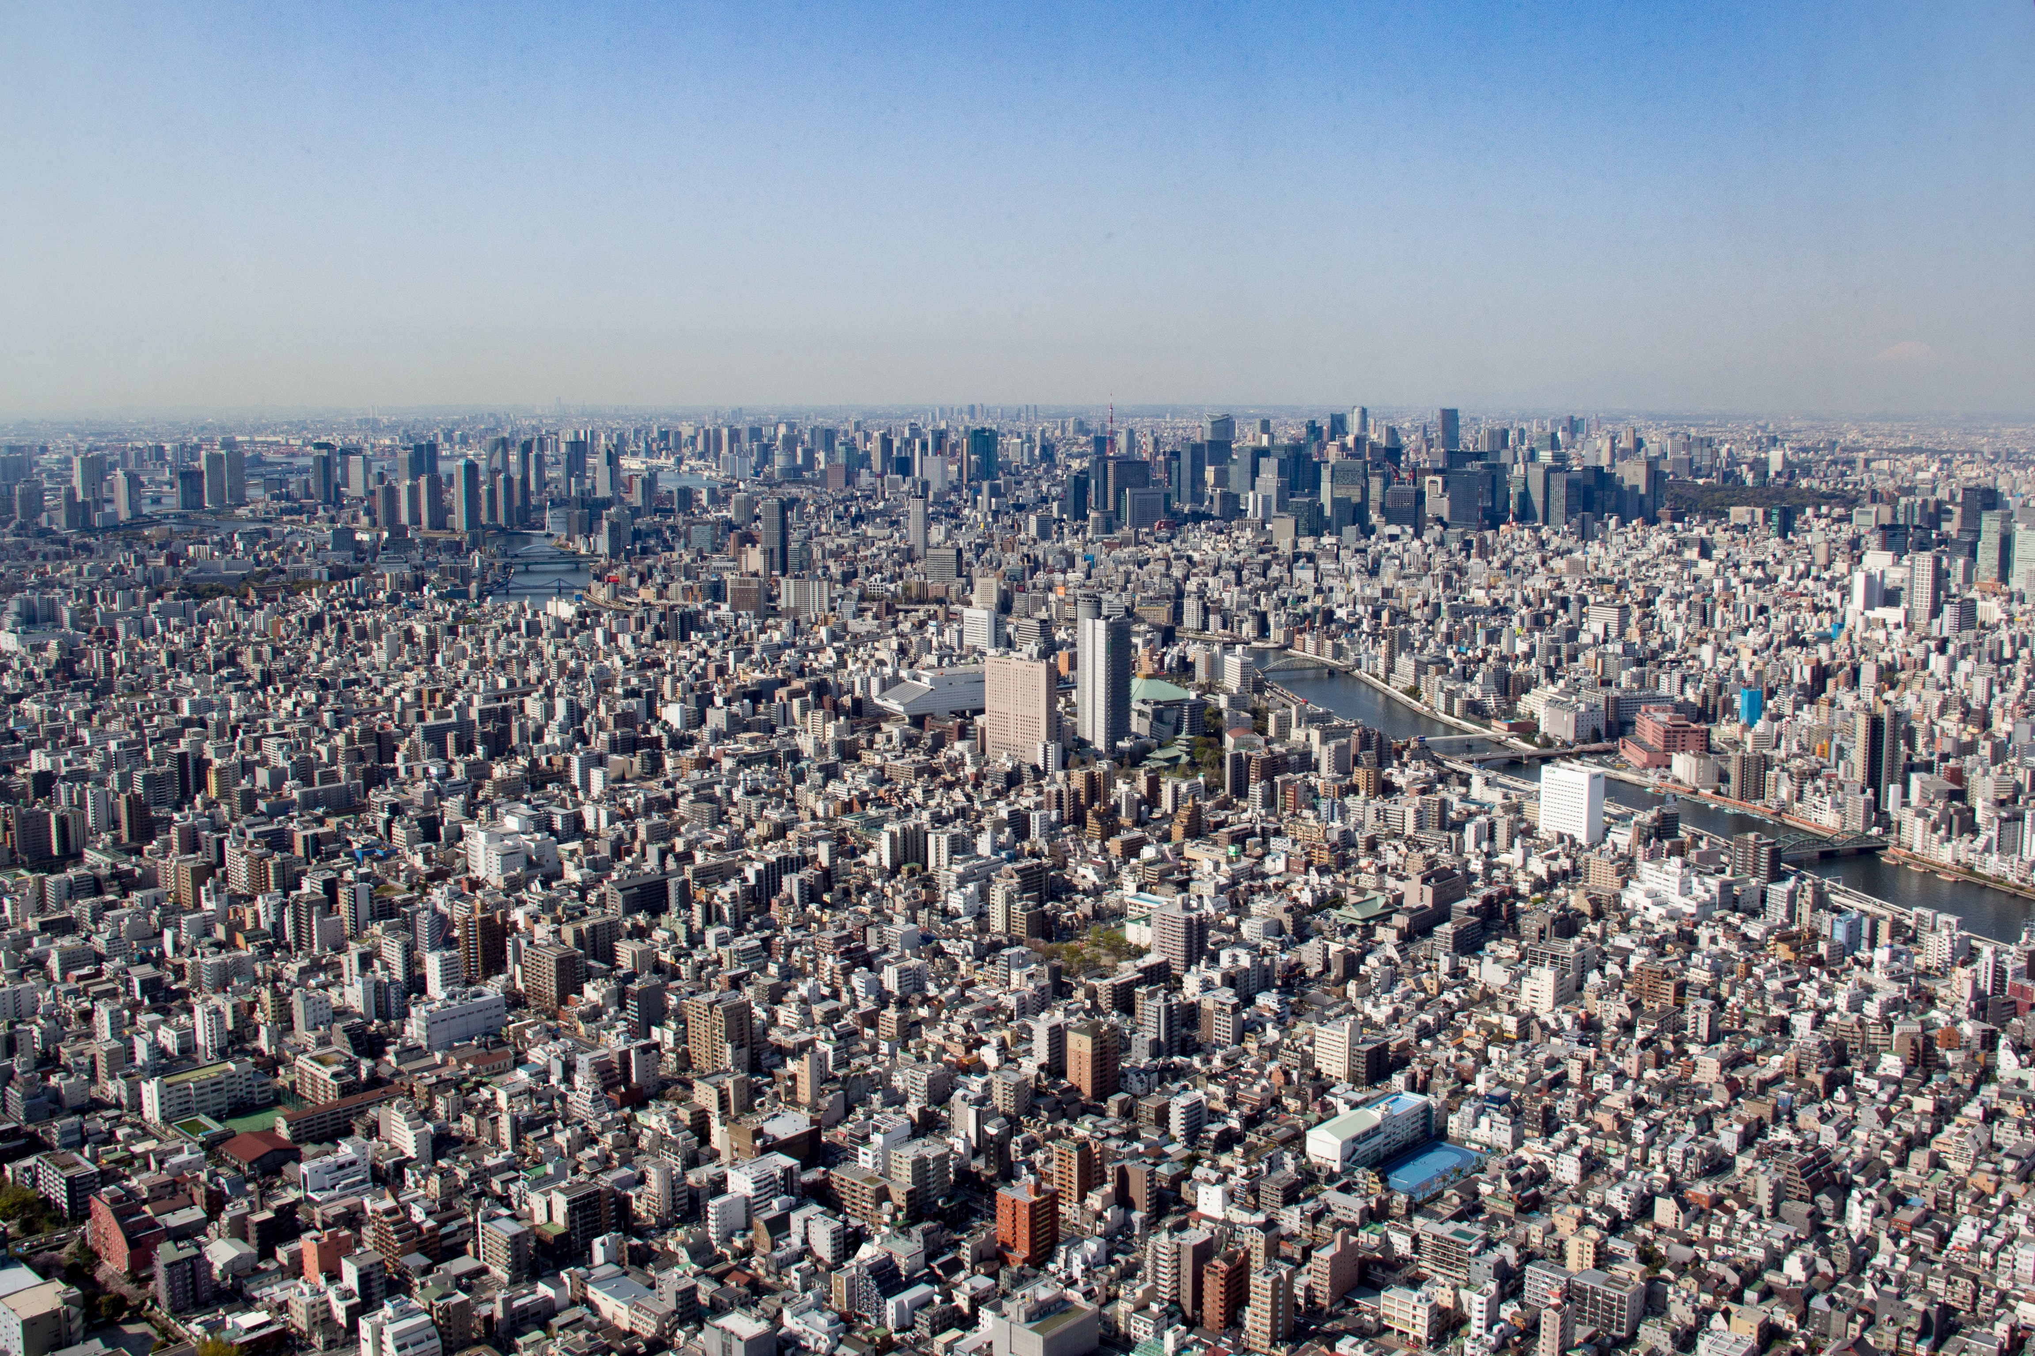
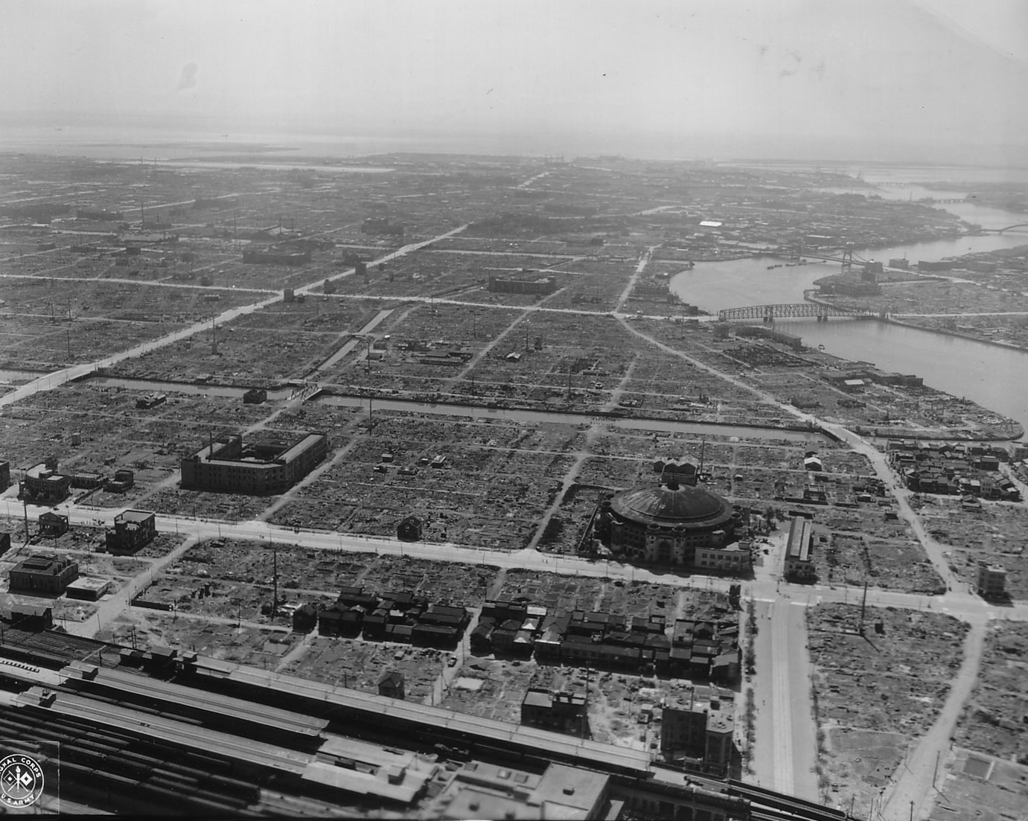
2. Speed of Change
Tokyo 2015
40 million
Tokyo 1945
3.5 million
Notes:
This is Tokyo after WWII, rising to become the biggest city in the world with about 40million people in 4 decades. Parallel to the picture of Shanghai.

Slide 7
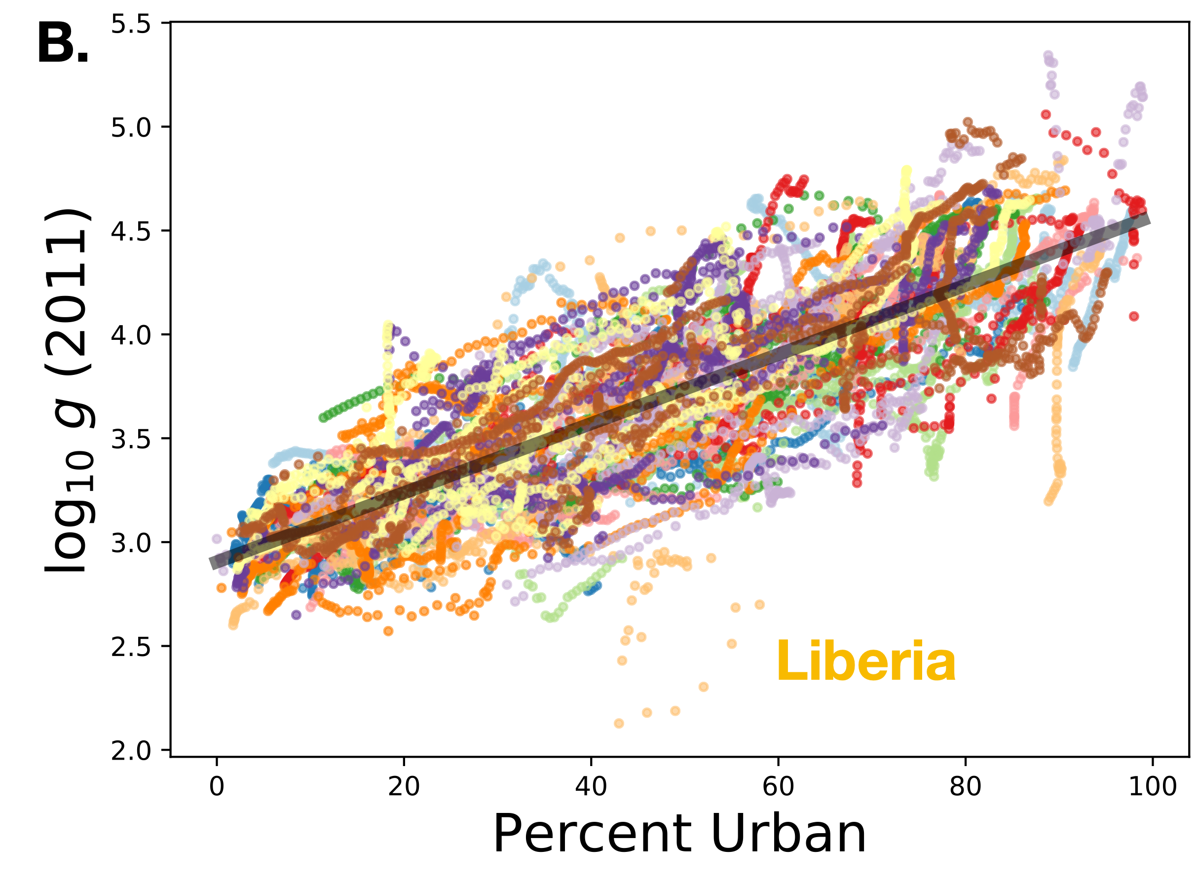
3. Economic Growth and Urbanization
National GDP per capita increases 4-5% with each percent increase in the percent of people living in cities
Notes:
Urbanization is related to systemic improvements in many measured of (human) development. We will see later why. This is a famous relation for economists interested in real economic growth.

Slide 8
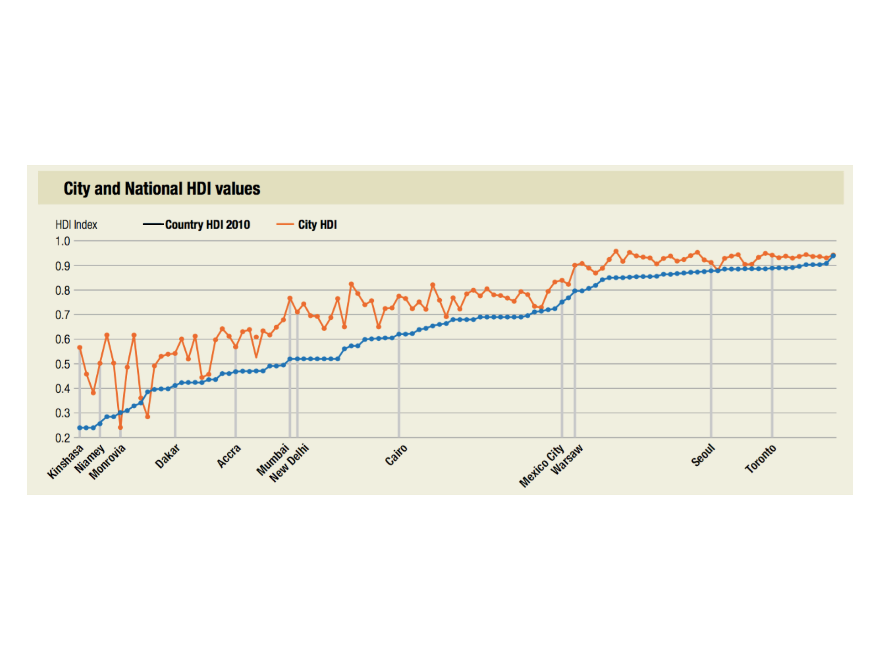
4. Human Development (knowledge, health, prosperity)
credit: UN-HABITAT: State of the World’s Cities 2012-13: The Prosperity of Cities
Larger Cities typically show higher Human Development levels than their nation
Notes:
And, the trend for economic growth also extends to life expectancy and education, the other two components of the Human Development Index. This plot shows a nations’s largest cities versus their national average. Monrovia (Liberia) had a particularly tough time with civil war, Ebola and many refugees.

Slide 9
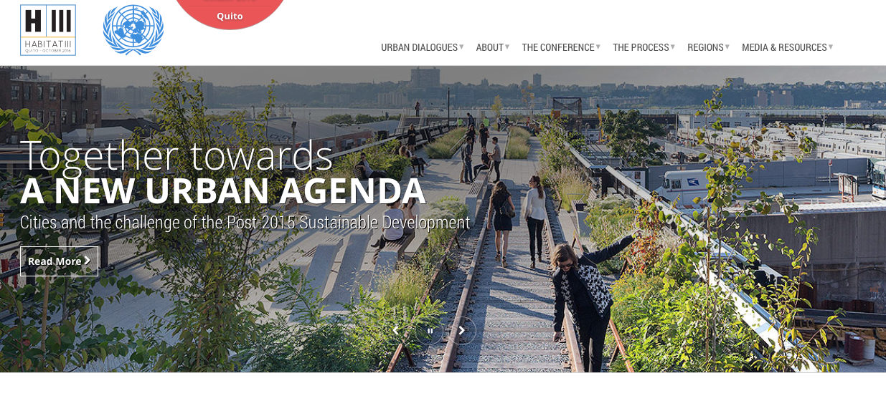
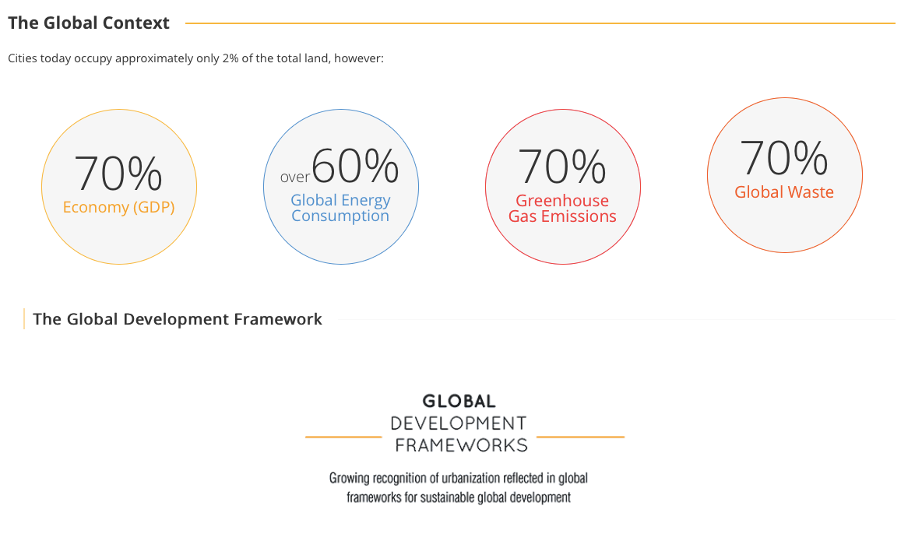
5. Sustainable Development
Notes:
But cities also are places of disproportionate consumption and GHG emissions.

Slide 10
Questions we would like to answer:
Why is urbanization happening everywhere?
Is it a blip or an irreversible transition?
Are cities leftwing or rightwing? Free markets? Social support nets?
Are there ideal cities (just, green, smart)? How do we get there?
When do cities produce (human) development?
Will urbanizing societies become “sustainable” fast enough?
Answers will require new interdisciplinary knowledge:
Understanding processes of innovation and development across scales,
Human reasoning and strategic decision making in diverse circumstances, culture,
Patterns of settlement, architecture and design, mobility and their influence on socioeconomic life,
Issues of inequality and inequity, justice and opportunity,
Resource uses, environmental costs, and their long term consequences,
Biodiversity change in disturbed environments.
Cities are the nexus for all these issues
There’s also lots of data, political will, agencies, money, long-term objectives…
If only we knew better what to do …
Notes:
Some questions that these observations raise, we will attempt to answer them as we go. The point tough is that you need to understand cities before you can answer them.

